Slide 1

Leadership Measurement Instruments
Alisher Siddikov

Slide 2
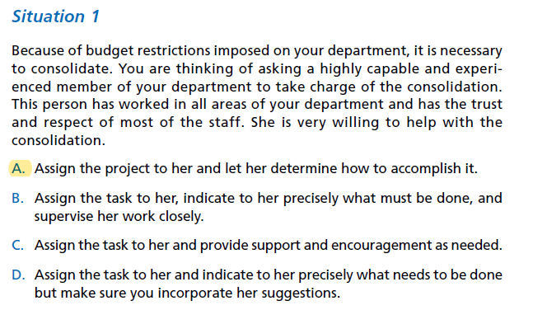

Situational Approach

Slide 3
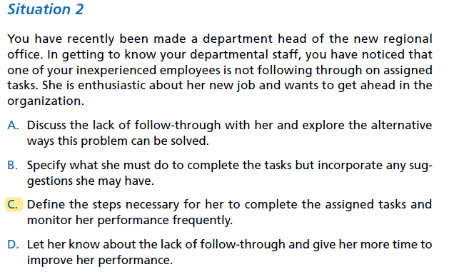
Situational Approach Cont.

Slide 4
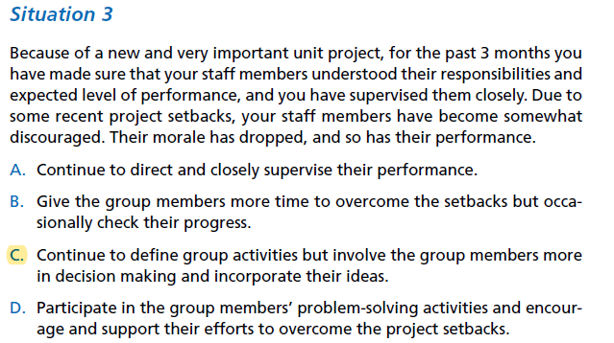
Situational Approach Cont.

Slide 5
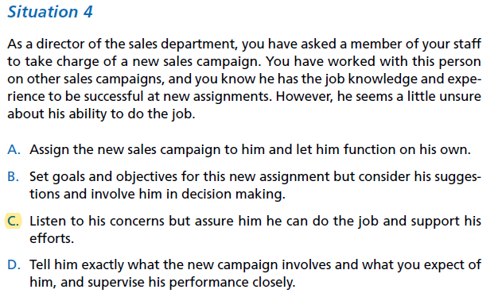
Situational Approach Cont.

Slide 6
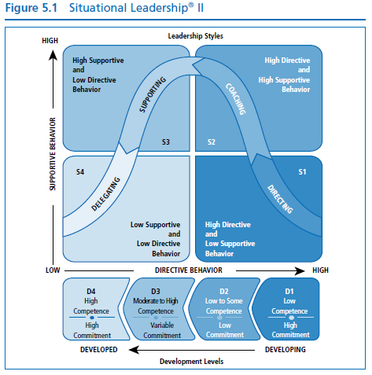
Situational Approach Cont.

Slide 7
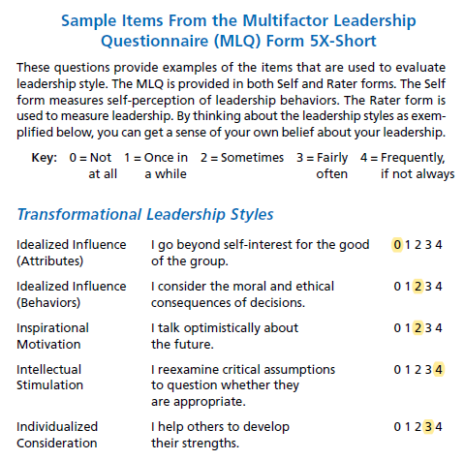
Transformational Leadership

Slide 8
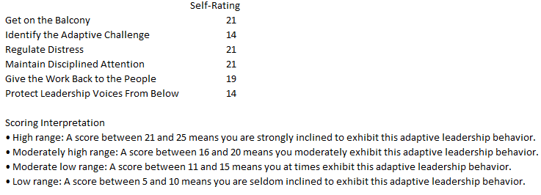
Adaptive Leadership

Slide 9
Conclusion
Top scores:
situational leadership, S1-directing
adaptive leadership, get on the balcony
adaptive leadership, give the work back to people
transformational leadership, inspirational motivation
Low score/improvement opportunity:
Coaching, mentoring, increase of support

